Slide 1


The Business Case For Sustainability

Slide 2
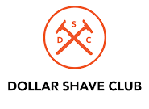





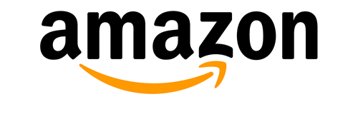



Ecommerce Is Crowded
There are at least 3 million ecommerce companies in the world. (There are 175 ecommerce MATTRESS companies alone!).
Barriers to entry are low. Platforms like BigCommerce, Shopify and Etsy mean that hundreds more are launched every day.
2

Slide 3

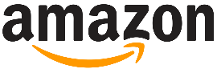
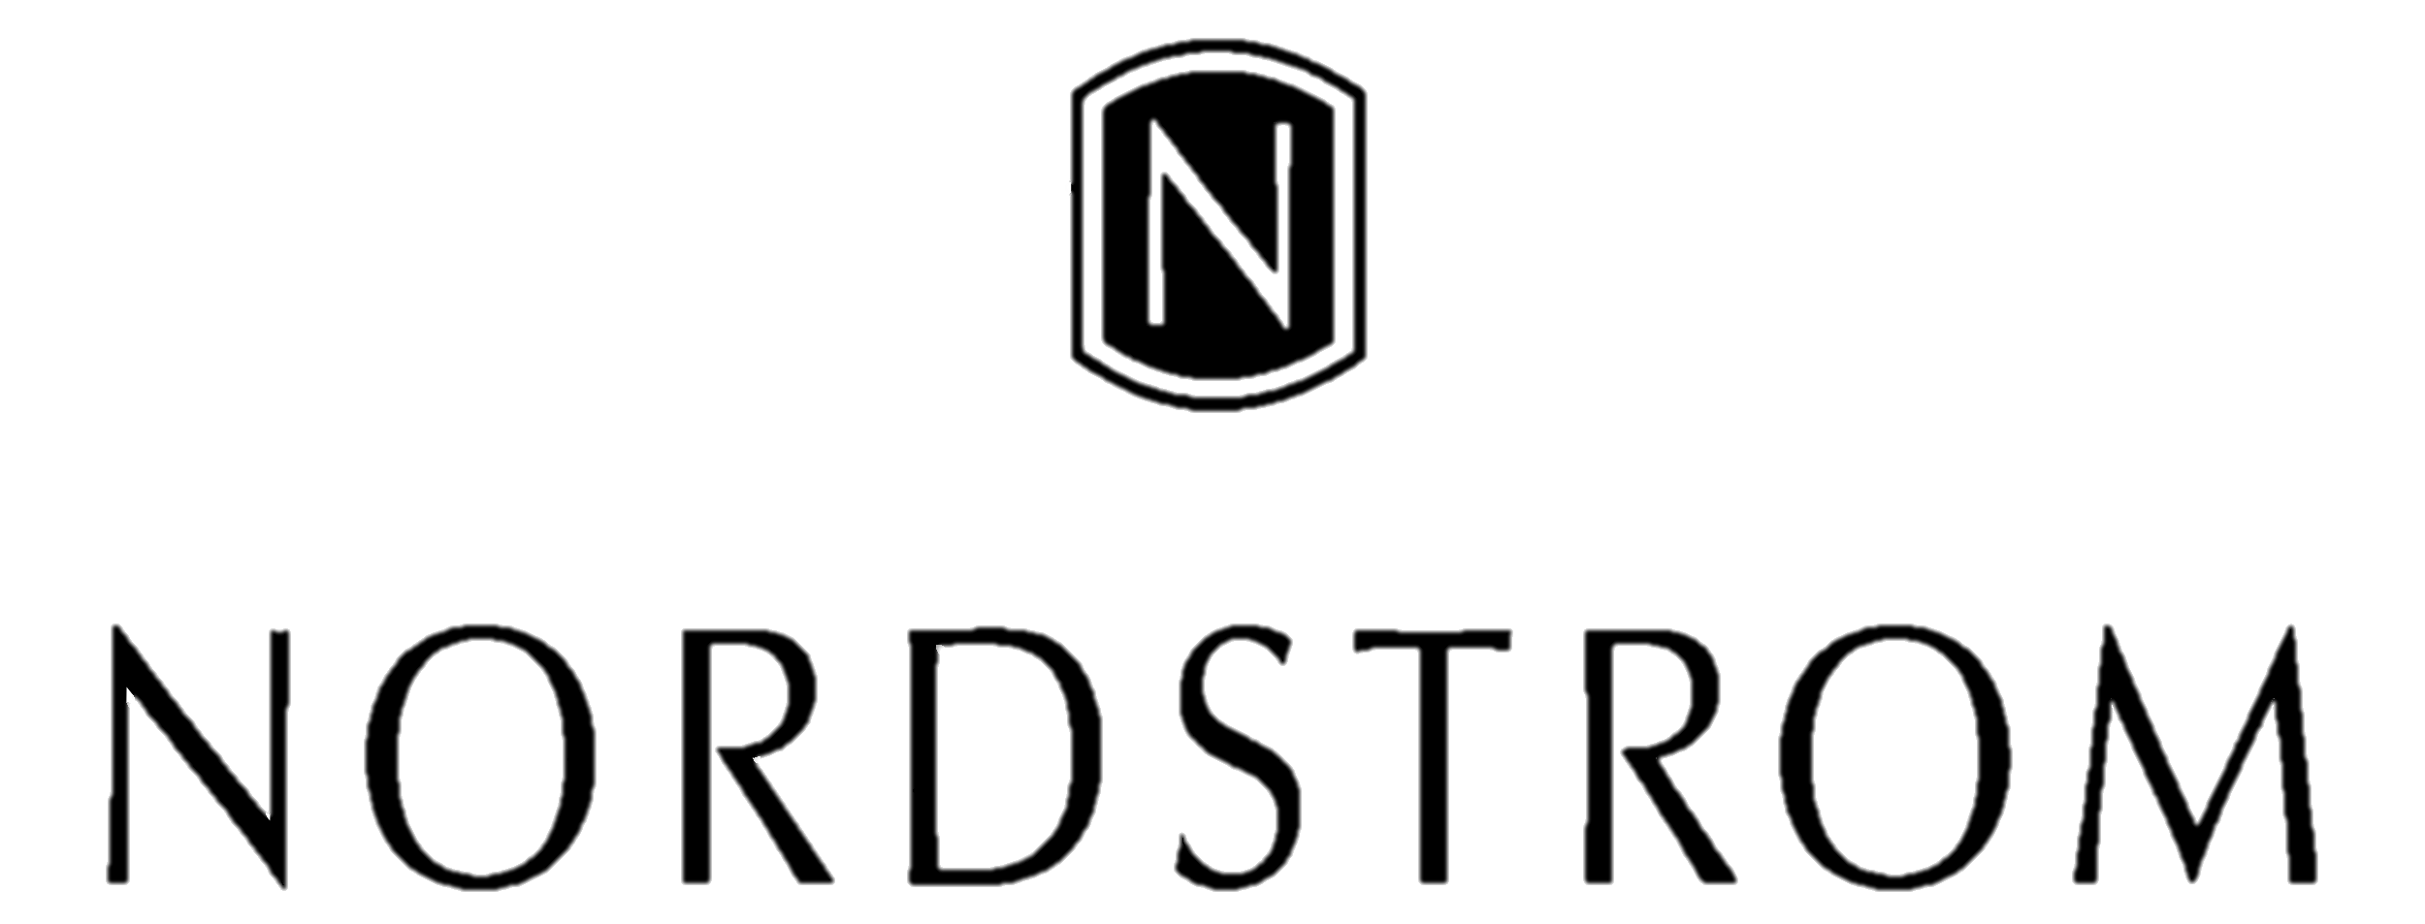
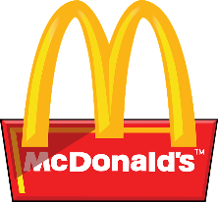


How Can You Differentiate?
Traditionally, a business school would tell you there are three main ways to differentiate:
Low price, fast
Low Price
High Quality (Great Taste, High Comfort, Great Style)
Excellent Service or Speed
High quality, excellent service
Low price, fast
Great service
High quality
3

Slide 4

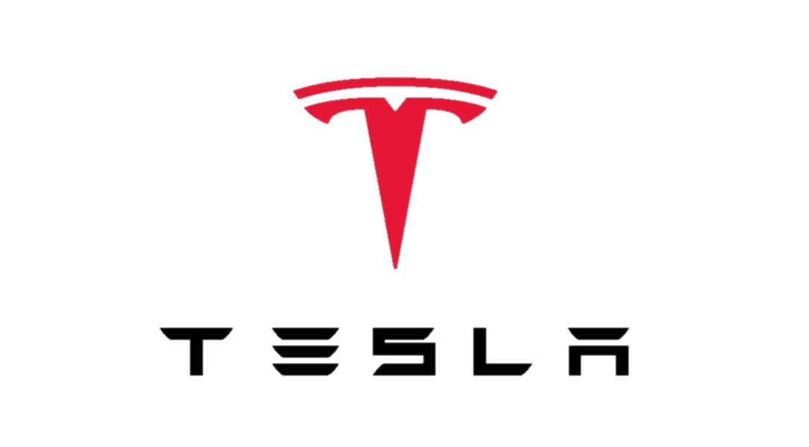


Differentiate through Sustainability
But we believe that sustainability has become a fourth critical point of differentiation.
And we think sustainability is a BIG opportunity.
Here are just three brands known for quality AND sustainability
4

Slide 5
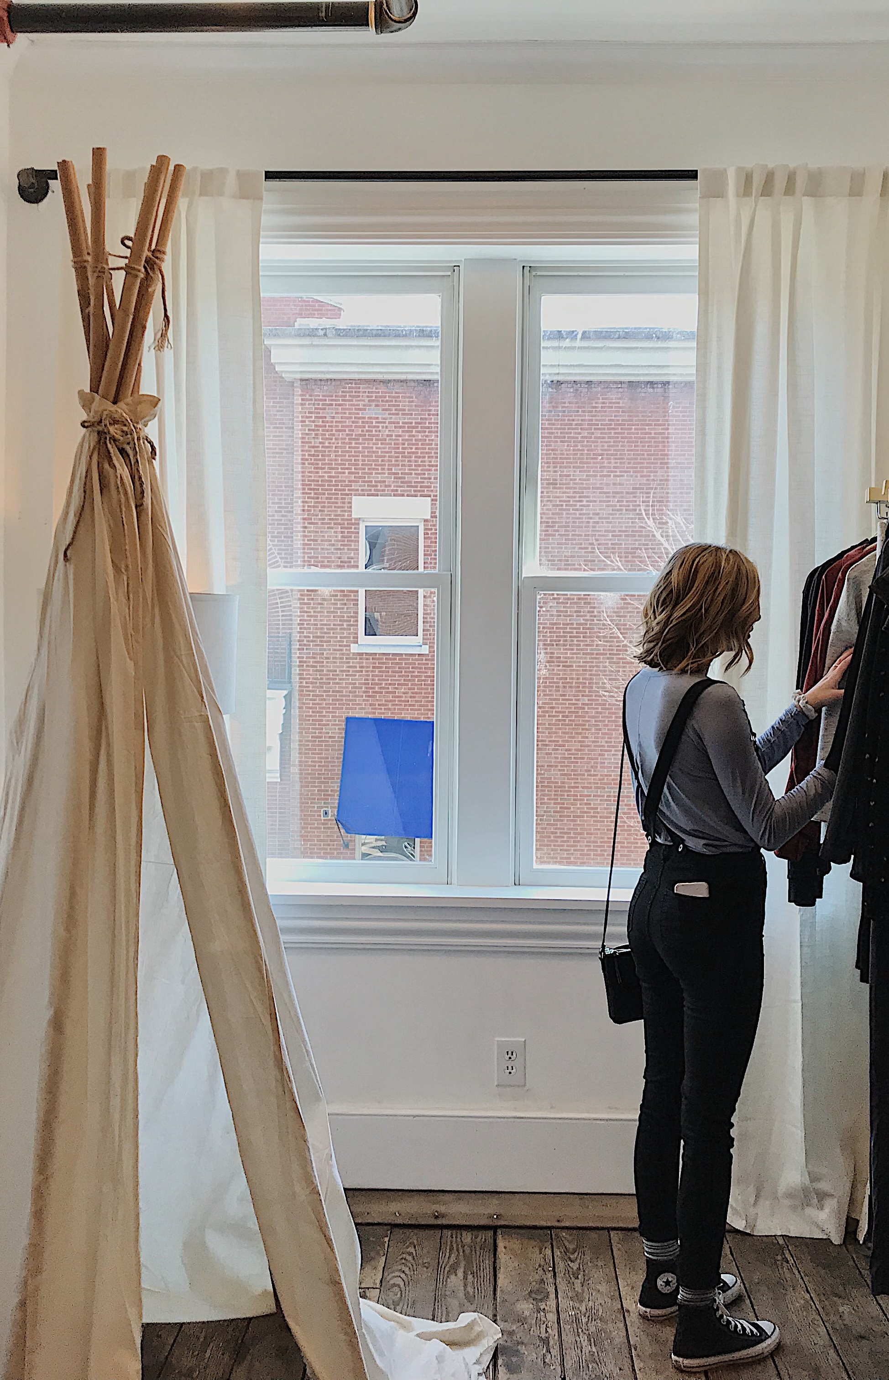
More and more, consumer purchasing is a form of activism and advocacy
For a growing base of people, “consumerism” is a bad word that conjures cheap and fast, and the sense that people have no power in their purchasing decisions.
Today’s consumers want their purchases to make a positive impact on the environment, on people, and on their health.
72% of consumers are actively buying more environmentally friendly products than they did five years age. 81% said they expected to buy even more over the next five years. (Accenture, 2019)
66% of consumers would spend more on a product if it came from a sustainable brand. One-third are willing to pay 25 percent more and Gen-Zers are willing to pay 50-100 percent more.(Nielson 2015)
Products that had sustainability claims on packaging accounted for 16.6% of the market in 2018, up from 14.3% in 2013. These products grew 5.6 times faster than conventional products in this time period.
https://www.businesswire.com/news/home/20190604005649/en
https://www.tradeandindustrydev.com/industry/retail/report-consumers-willing-pay-sustainability-15246
https://hbr.org/2019/06/research-actually-consumers-do-buy-sustainable-products
5

Slide 6
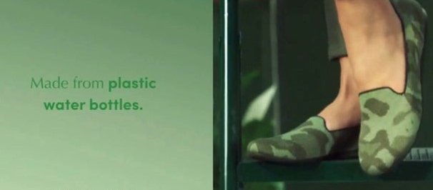
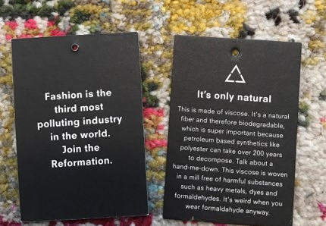
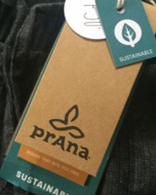
Making Sustainability A Core Strategy To Your Online Business Can Set You Apart, Especially In Ecommerce Where Your Brand Can Truly Tell Its Own Story.
6

Slide 7
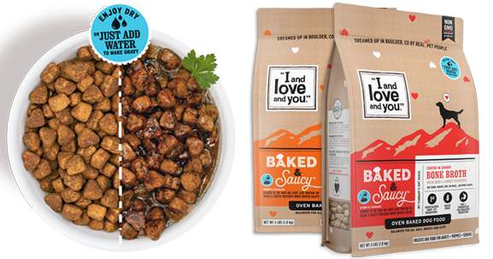
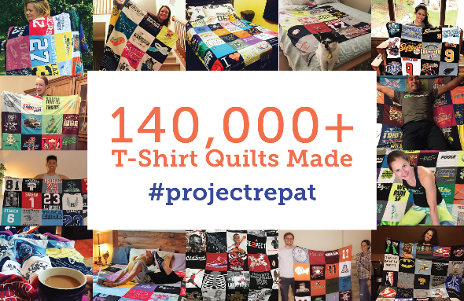
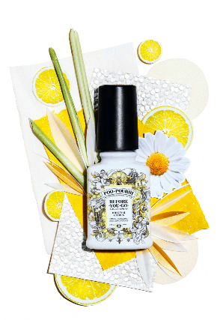
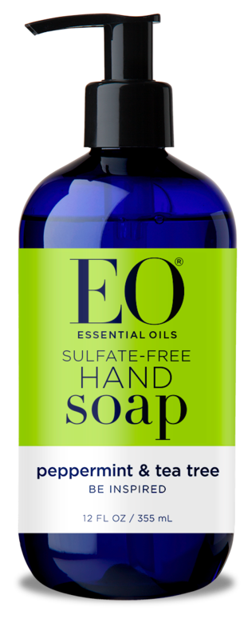
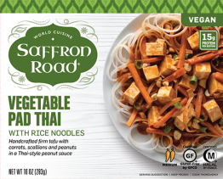
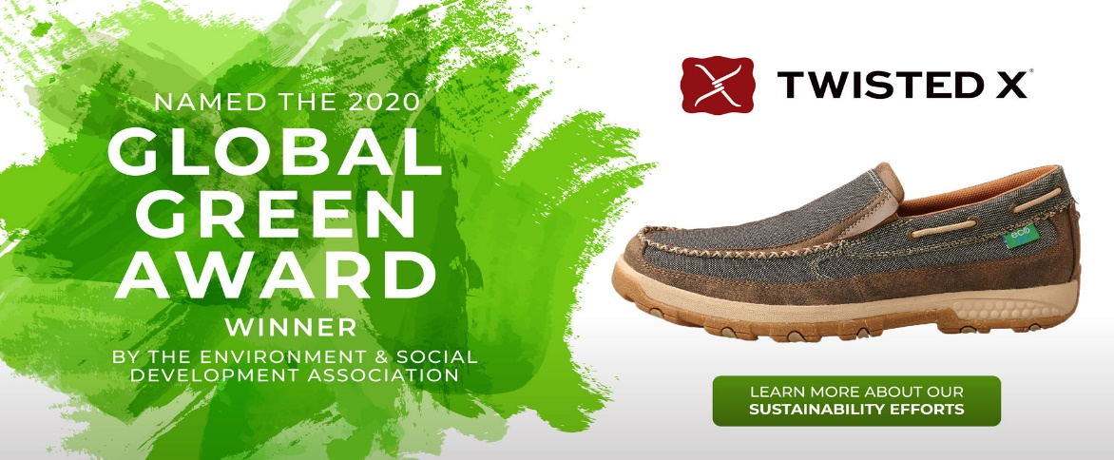
A review of the 2019 list of Inc 5000’s fastest growing relevant retail and consumer products companies shows that nearly 25% of them highlight ethics and/or sustainability on their homepage.
7

Slide 8


Still Need Convincing?
Here’s WHY and HOW
Sustainability Can Set You Apart.
1
Brand awareness and customer acquisition: Ecommerce stores acquire customers through a variety of strategies -- organic traffic (which require high SEO rankings!), promos through blogs and influencers, social media, newsletters, paid ads and more. A company making their products out of reclaimed goods, using sustainable inks, offsetting their carbon footprint, and running community cleanups weekly is far more likely to have interesting content, generate a social following, and get PR than a standard run of the mill brand.
Reformation was founded in 2009 to make edgy, sexy, and feminine apparel using sustainable methods and materials. The company provides sustainability detail (carbon emissions saved, water saved, waste saving) on each item it sells and generated an estimated revenue of over $100 million in its 8th year (in no small part because of celebs and influencers who jumped on board – such as Rihanna and Taylor Swift).
2
Customer loyalty and referrals: Orders shipped in premium, sustainable packaging that highlight’s a company’s commitment to sustainability can inspire customers to stay loyal and repurchase. This type of packaging experience makes customers feel proud of their purchase, motivating them to share the brand with friends or on social media.
EcoTools, which has a line of recycled, sustainable makeup brushes translated their deep commitment to eco-friendly and ethical practices into a variety of social media movements. #MyTrueBeauty was one such movement that inspired customers to promote messages of true beauty, which fueled donations to organizations that support women and sustainability.
8

Slide 9

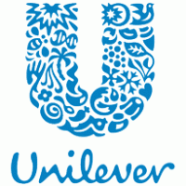
Still Need Convincing?
Here’s WHY and HOW Sustainability Can Set You Apart.
3
Innovation and growth: Brands that put sustainability first must also put innovation first. Innovation is essential to sales and customer growth, and it makes a business more interesting to run, work at and market.
Interface Carpets founder, Ray Anderson, reoriented his company towards sustainability in 1994. Since then, the company (with over $1.2 billion in revenue!) pioneered carpet tiles which now account for 20 percent of total sales across the carpet industry.
4
Employee engagement: Companies rooted in ethics and the planet are often better places to work. They are more dynamic, they tend to be more open to feedback from their customers and employees, and they are a place where people are proud to work. This leads to more productive, engaged and loyal team members.
Unilever, arguably one of the most sustainability oriented of the big CPG companies, has a slogan: “Small actions can make a big difference” which energizes and engages its workers worldwide. In one such example, tea factory workers in Great Britain reduced the end seals of each tea bag by 3 millimeters, saving 15 huge reels of paper every shift (and saving 20.5K lbs of paper and $62,000 dollars since 2015).
9

Slide 10

Ready To Go? Check Out Our Comprehensive Guide To Building A Sustainable Ecommerce Business.
Setting goals and measuring
Designing and sourcing raw materials for your product
Product manufacturing
Warehousing and fulfillment
Product and shipping packaging
Designing for end of life
Inventory management
Shipping and transportation
Managing returns
Office operations and work environment
Corporate activism and engagement
Marketing
10

